Slide 1
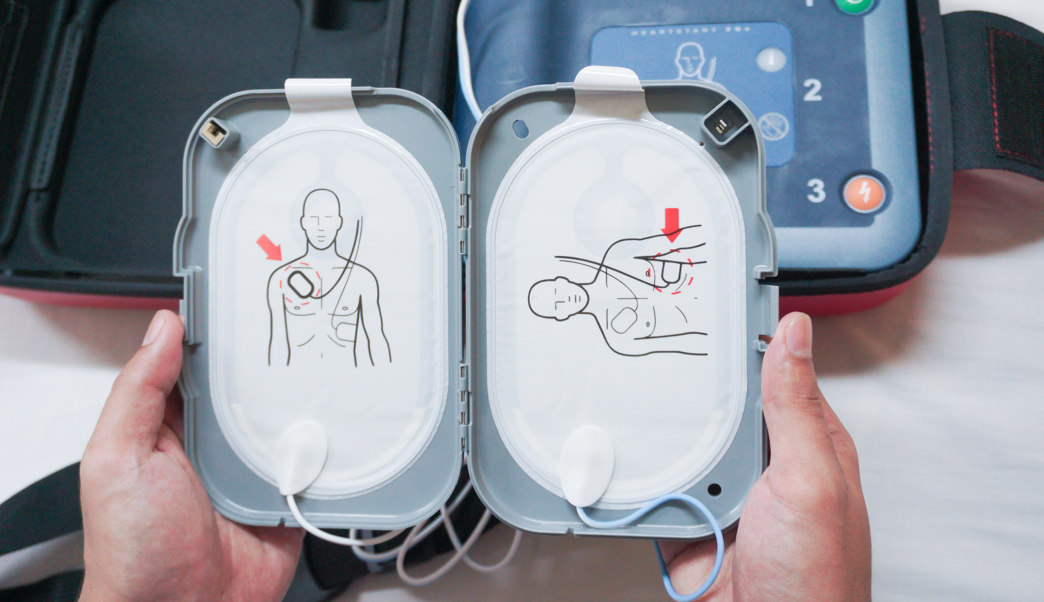
Project S.A.V.E.
All Staff Awareness Training
Notes:
Note* for this training please allow 10-15 minutes to go through the presentation.
-ask to present at an all staff meeting if possible; if not can be done in groups during grade-level/subject planning times
-include the campus map highlighting AEDs on slide 20
-remind the staff that it is important for everyone to be aware of SCA and the basics of CPR/AEDs
Sudden Cardiac Arrest training for staff to keep up with Heart Safe Application/Renewal

Slide 2
What is Project S.A.V.E.?

Slide 3
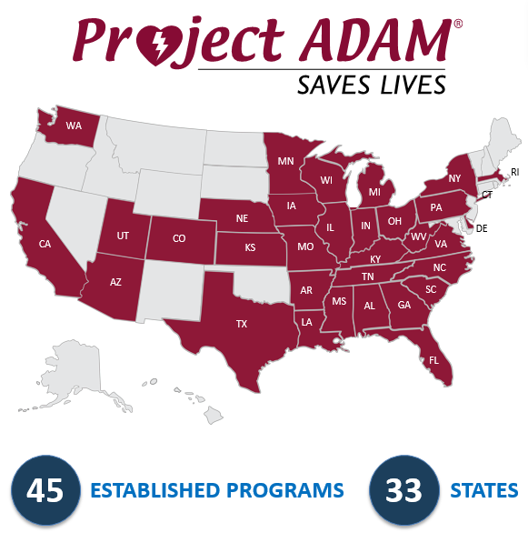
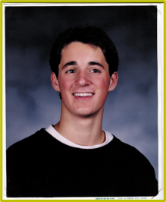
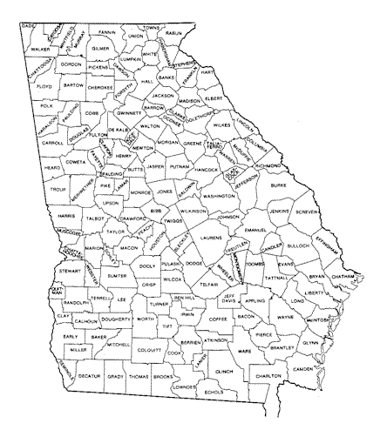
Project S.A.V.E
First affiliate of Project ADAM, a nationwide initiative that has saved the lives of more than 200 children, adolescents and adults.
S
Sudden cardiac arrest
A
Awareness
V
Vision for prevention
E
Education
Notes:
Speaker Comments:
We have been working towards becoming/are a designated Heart Safe School with Project S.A.V.E. Project S.A.V.E started in 2004 as the first affiliate of Project ADAM, with a mission of preventing sudden cardiac arrest in children, teens and young adults in Georgia communities. Project ADAM takes its name after Adam Lemel, a 17-year-old Wisconsin high school student who collapsed and died while playing basketball. Adam suffered a sudden cardiac arrest, in which an AED could have been used to save his life
Being a Heart Safe School with Project S.A.V.E means we will experience annual Project S.A.V.E. all staff training as well as participate in ongoing cardiac emergency response (AED) drills. The AED drill is an exercise that helps us to measure our preparedness and identify opportunities for improvement in our process.

Slide 4
Project S.A.V.E.
Notes:
Speaker Comments: Now we will watch a video of Claire who suffered a sudden cardiac arrest during a high school volleyball game.

Slide 5
Project S.A.V.E.
Notes:
Speaker Comments: The next video we will watch is about Collin, who suffered a sudden cardiac arrest at school after running up a flight of stairs.

Slide 6
What is sudden cardiac arrest (SCA)?
SCA often occurs from a sudden and unexpected disruption in the heart’s electrical system
Stops blood flow to the brain and vital organs
Occurs in approximately 350,000 people/year in community settings
Differs from a heart attack
Notes:
Speaker Comments:
Sudden Cardiac Arrest is a life-threatening emergency. Recognizing the signs of SCA, starting CPR and using an AED is critical, as death can happen in minutes.

Slide 7
Notes:
Speaker Comments:
Sudden Cardiac Arrest Video: (Review message from Dr. Whitehill, Project S.A.V.E. Medical Director)

Slide 8
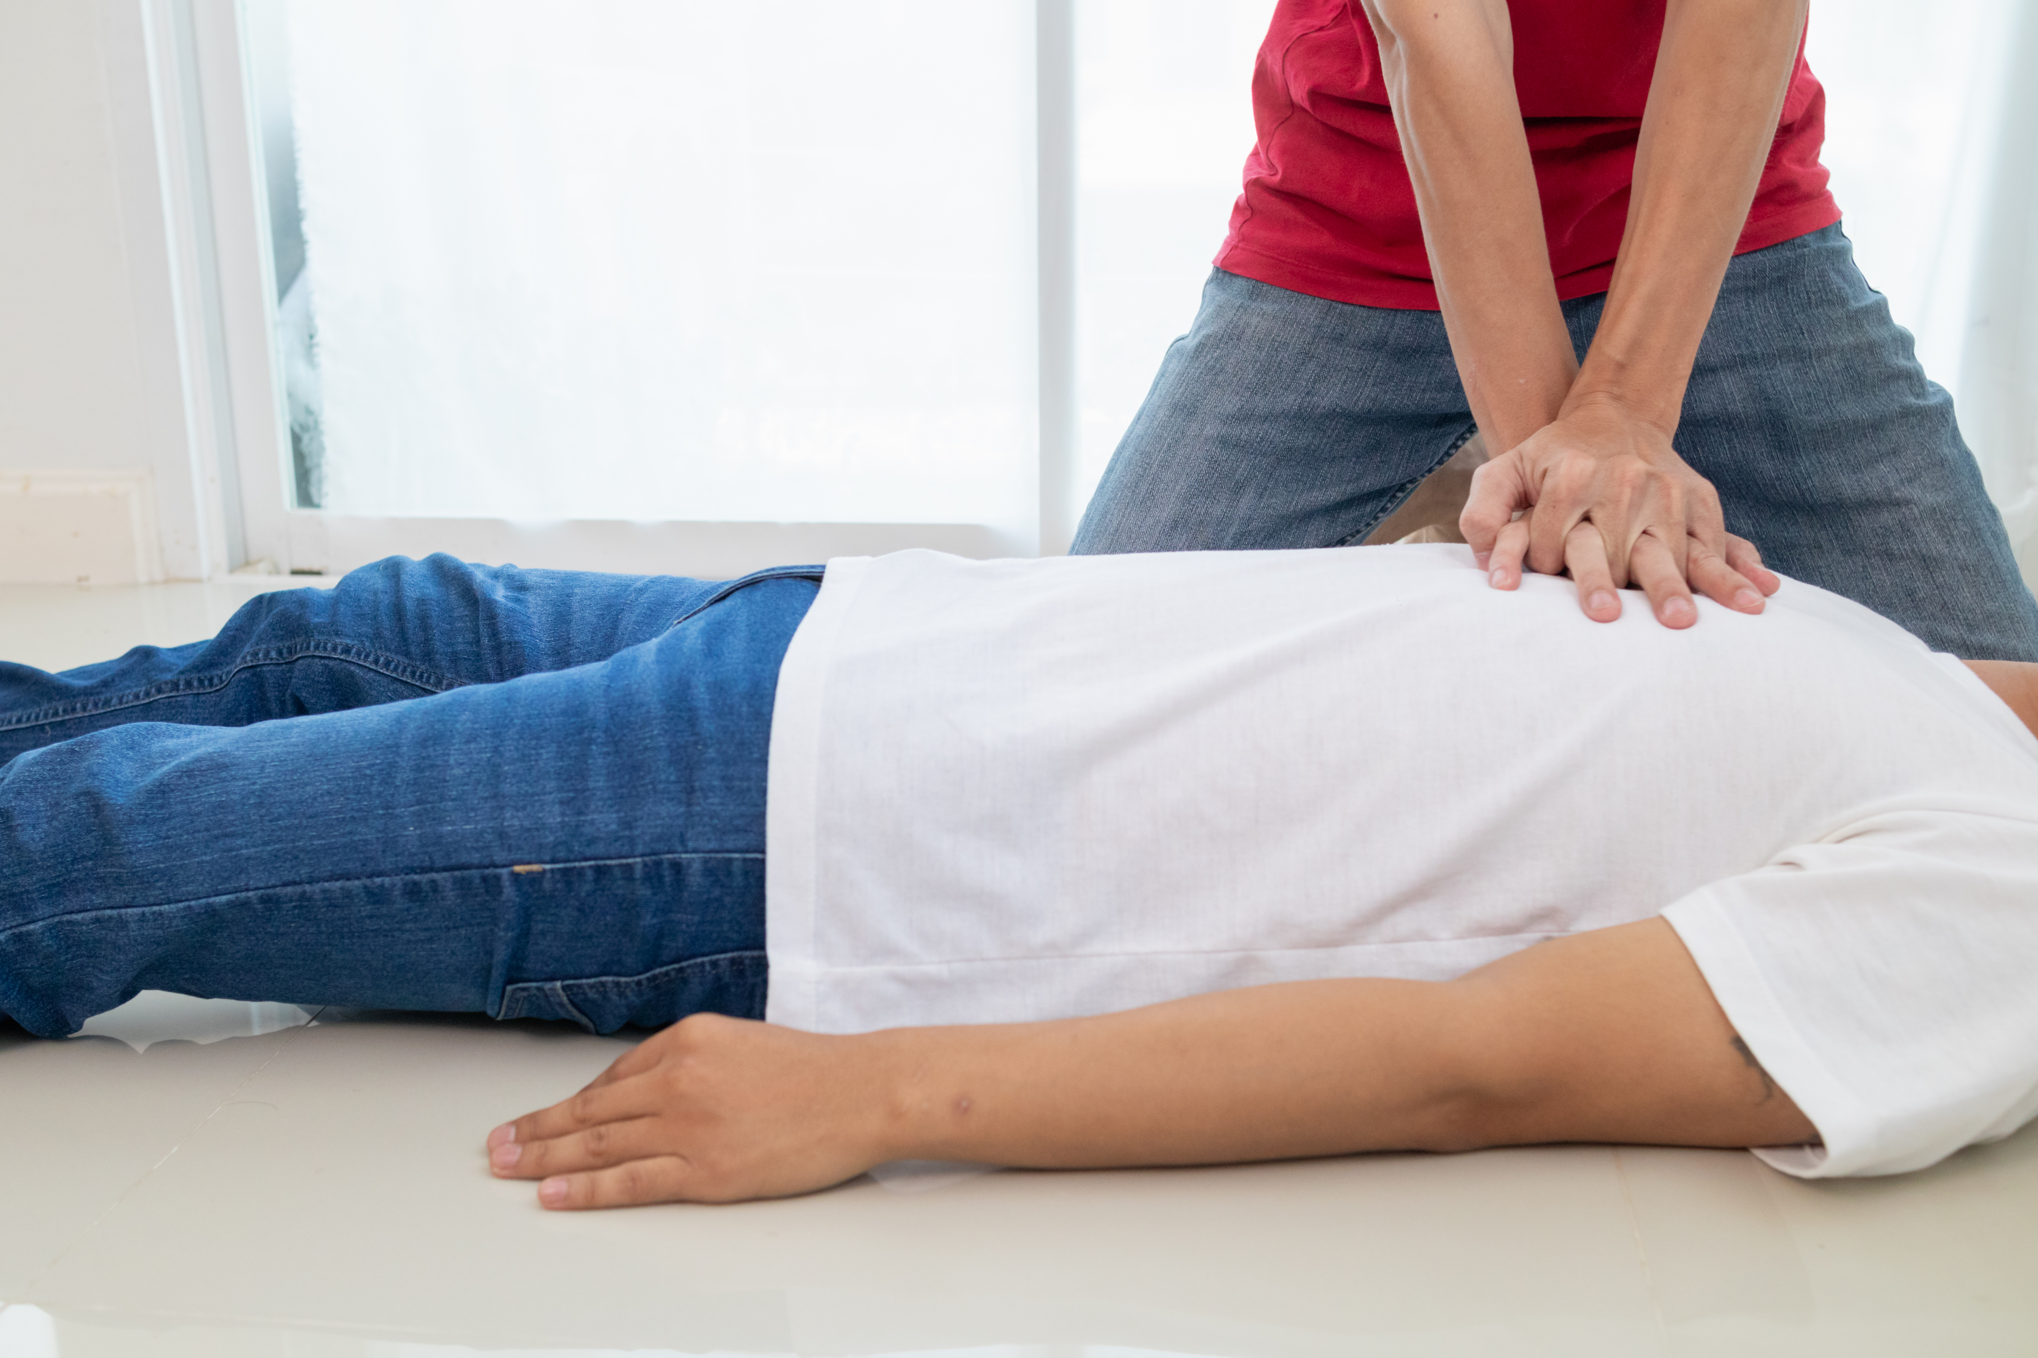
What causes SCA?
Not all causes are known
Several structural and electrical diseases
Common arrhythmia, ventricular fibrillation
Most conditions are inherited in children
Other causes:
Sudden blunt blow to the chest
Use of recreational or performance-enhancing drugs

Slide 9
Sudden cardiac arrest can happen …
Anytime
Any place
To anyone
Are you prepared?

Slide 10
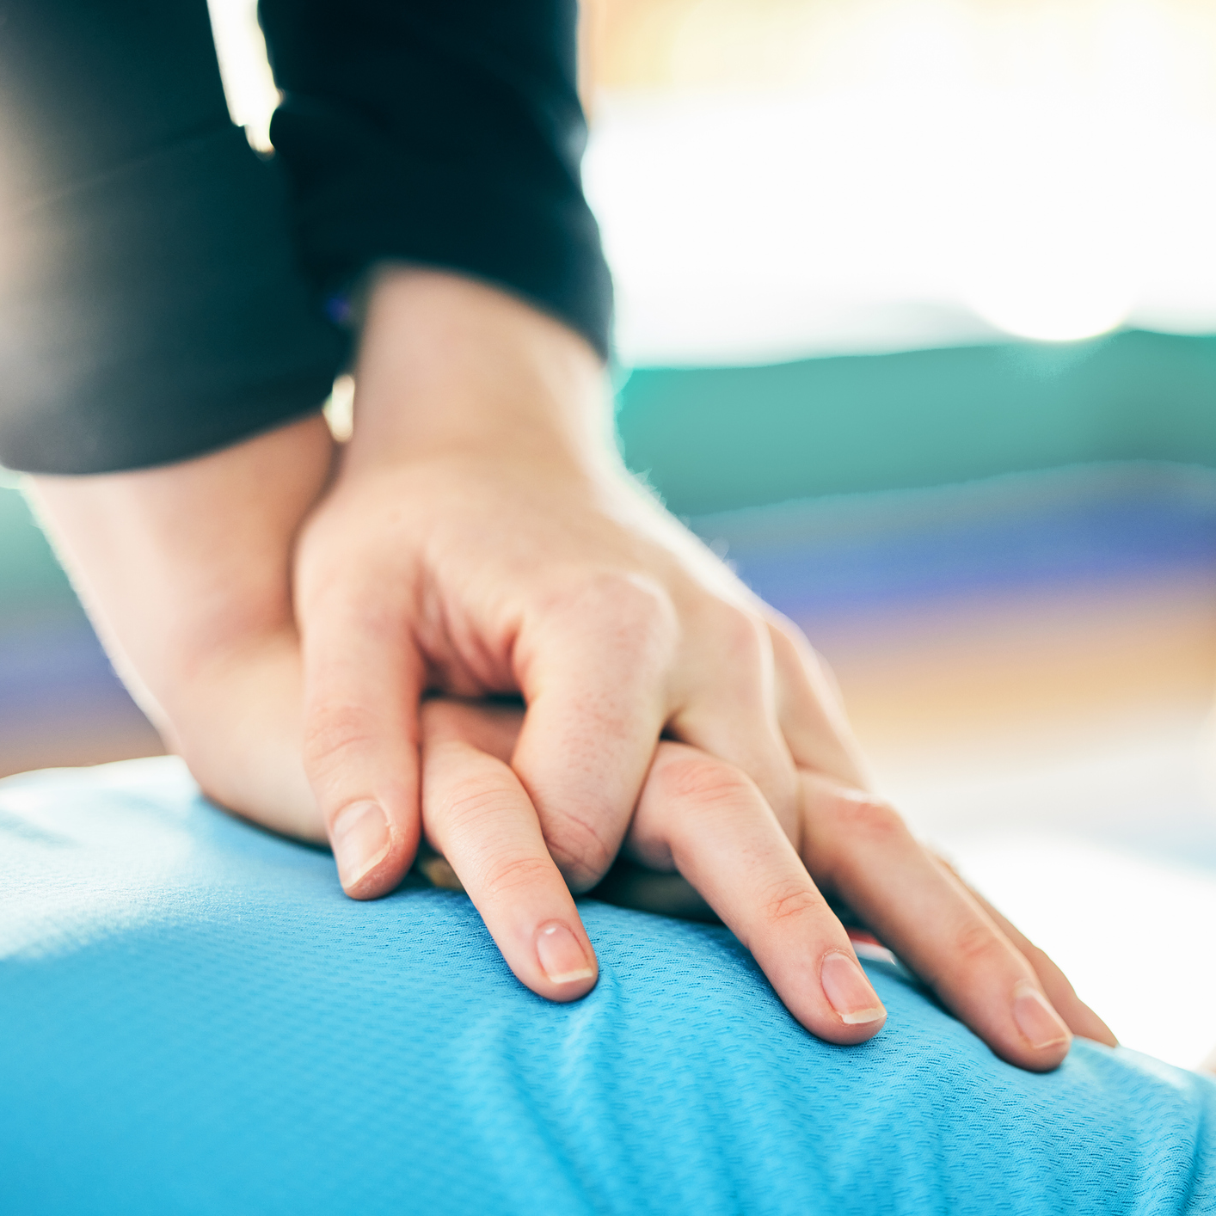
Do you know…
What to do if a child (or anyone) collapses?
What a sudden cardiac event looks like?
How to do hands-only CPR?
Where the AED is and what it’s used for?

Slide 11
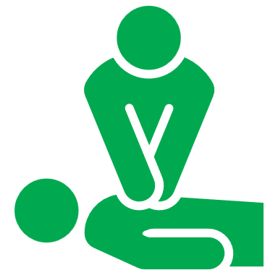
Protecting students, staff and visitors
1
2
3
Learn the early warning signs of Sudden Cardiac Arrest
Learn how to recognize Sudden Cardiac Arrest
Learn hands-only CPR

Slide 12
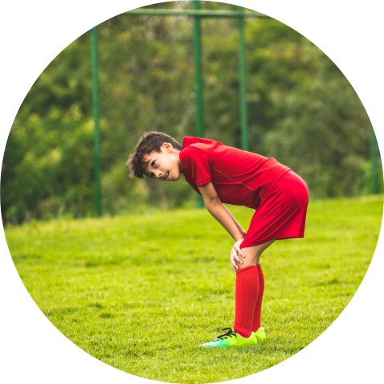
1. Learn the early warning signs
1
Sudden fainting or seizures during exercise
Dizziness
Extreme fatigue
Chest pain
Racing heart (palpitations)
Unexplained shortness of breath during exercise
Family history of heart disease/cardiac arrest
Family members unexplained and unexpected death before age 50
Family members diagnosed with hypertrophic cardiomyopathy (HCM) or Long QT syndrome
Fainting or seizure from emotional excitement, distress or being startled
Notes:
Speaker Comments: Knowing the warning signs and how to respond quickly, is critical to saving lives.

Slide 13
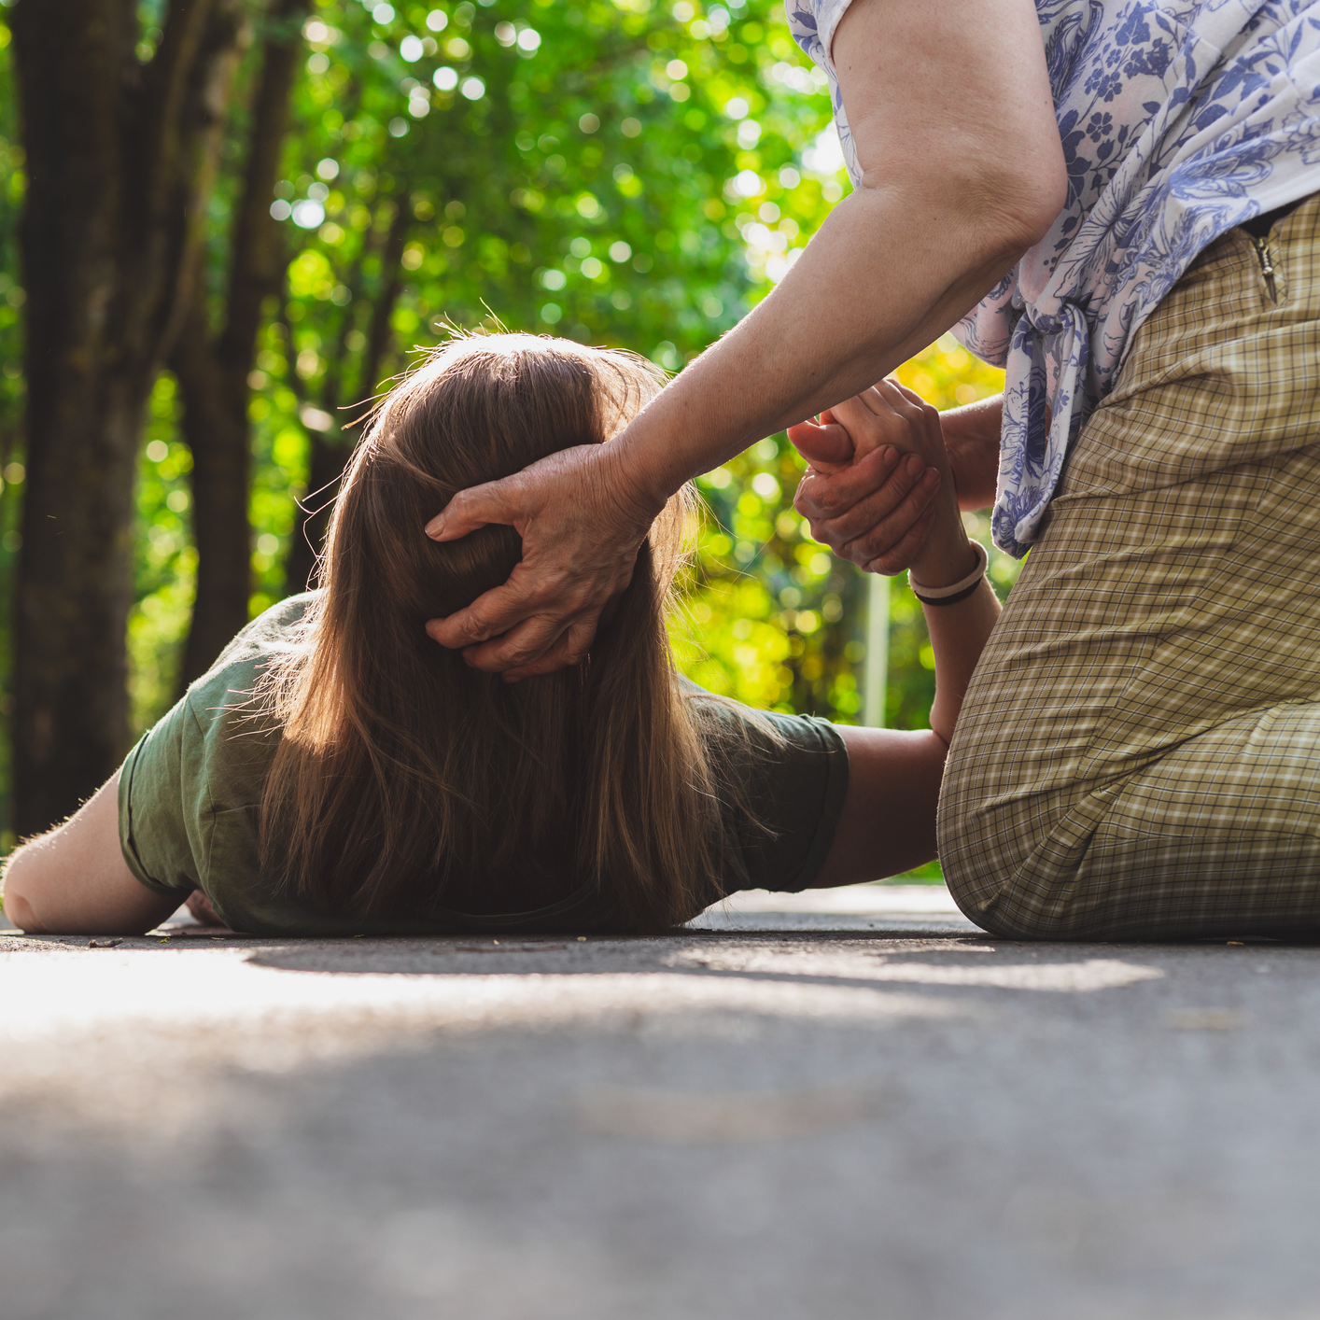
2. Learn how to recognize SCA
2
When someone collapses suddenly:
Assume sudden cardiac artrest
Respond quickly
Victim will be
Unresponsive, not moving, or unconscious
Gasping or not breathing normally
Potentially having jerking movements
Send for help (Call 911)
Start CPR
SCA can also occur to those who collapse shortly after being struck in the chest by a firm projectile/direct hit.
Notes:
Speaker Comments: There are little to no warning signs with SCA. Often victims are the picture of health out for their daily run or in the middle of a ball game when they suddenly collapse.

Slide 14
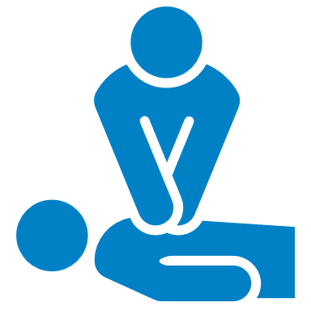
Key SCA warning signs and symptoms
Unconscious
Unresponsive
Pulseless
Caveats: Seizure activity, gasping/agonal breathing, drifting in and out of consciousness may precede arrest
Arrest
vs.
Attack

Slide 15
3. Learn CPR
3
Effective CPR saves lives by circulating blood to the brain and other vital organs until advanced emergency care arrives.
CPR is one of the most important skills you can learn, and it’s easy.

Slide 16
Hands-on CPR
1
Call 911 and get an AED
2
Push hard and fast in the center of the chest.
Kneel at victim’s side, place your hands on the lower half of the breastbone (one hand on top of the other), elbows straight and locked.
Push down 2 inches, then release up 2 inches, at a rate of 100 to 120 times/minute. (To the tune of “Staying Alive”)
3
If an Automated External Defibrillator (AED) is available, open it and follow the voice prompts.
Notes:
Speaker Comments:
If you are the first one to find the victim and not certified in CPR/AED, you can call for help and start hands-only CPR until the Cardiac Emergency Response Team arrives. The Cardiac Emergency Response Team are trained and certified in CPR/AED. They will follow the cardiac emergency response plan and continue resuscitative efforts.

Slide 18
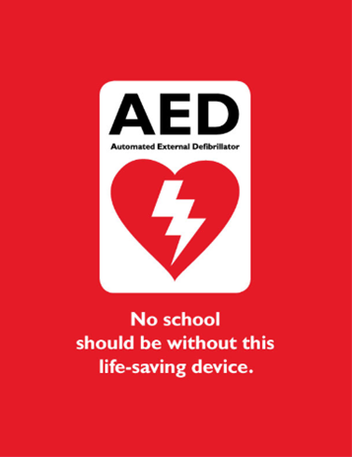
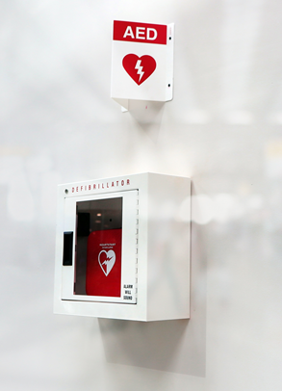
Automated External Defibrillator (AED)
Device used to evaluate heart rhythms and deliver a shock if needed
Voice prompts to guide you step-by-step what to do from the moment it is turned on
Remember to turn on the AED as soon as it arrives.
Notes:
Speaker Comments: Devices should be stored in an unlocked case. Most cases have an alarm when opened. This alarm does NOT notify EMS, but can serve as an alert for the Cardiac Emergency Response Team to respond.
-show staff an example of school’s AED & items located in the bag
-show how simple it would be to turn on the AED
-using an AED trainer, or YOUTube video allow them to hear what it sounds like when activated.

Slide 19
AED
Quickly delivers an electrical shock to return the irregular heart rhythm to a normal rhythm.
Shock delivered within 3 to 5 minutes may save a life.
Survival rates decrease by 10% with each minute of delay.

Slide 20
Where are our AEDs?
Campus Map
Highlight AEDs
Notes:
Speaker Comments:
Remind teachers/staff to think of where their classrooms are and frequent spots such as playground, cafeteria, specials, etc. to think about where the AED nearby is placed. (Insert location of AEDs on school campus here)

Slide 21
What does it take to be a Heart Safe school?

Slide 22
Heart Safe school checklist
AED placement
AED signage
AED maintenance check
Accessory kit with or near AED
CPR-AED site coordinator
Cardiac Emergency Response Team (5 to 10 members)
Written cardiac response plan
Clear communication (e.g., “Code AED”)
EMS have been notified of CPR-AED program
Plan shared with outside groups using facilities
CPR-AED training for team members
All staff know location of AED
All staff awareness training
Cardiac emergency response drill
Notes:
Optional Slide*
Speaker Comments:
All the steps the nurse (Site Coordinator) is completing with Project S.A.V.E
Items to point out:
We have established a Cardiac Emergency Response Team and a plan in the event of a SCA. Part of this plan is that the entire staff is aware of the procedure. Ask response team to stand. These people have agreed to serve as our school response team. They have been trained in CPR and AED use (or they will be shortly!) and will come to your aid when needed. Whether or not you are on the “team,” you are responsible in some way.

Slide 23
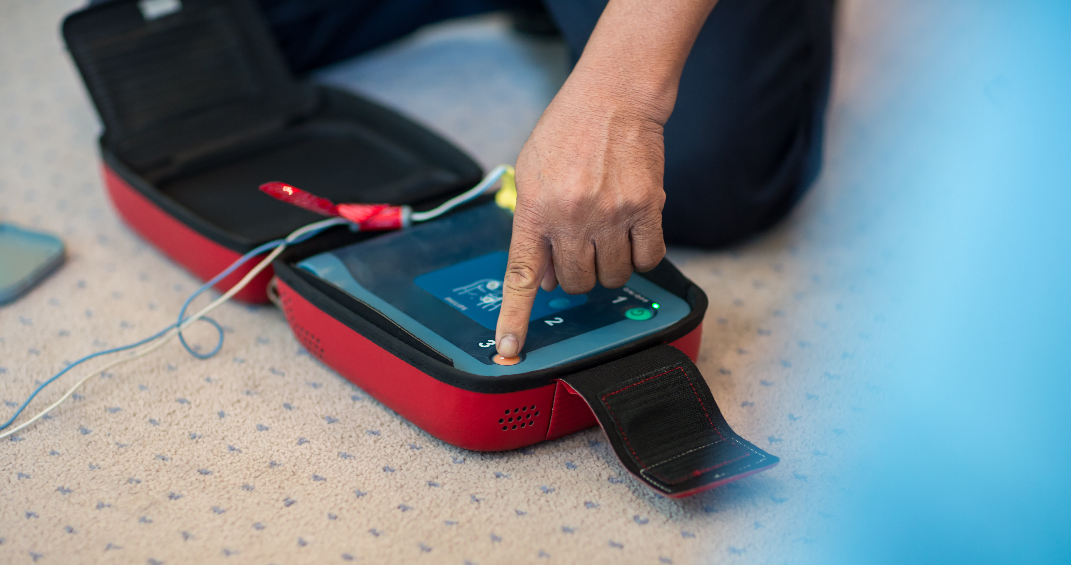
Our plan
Recognize that Sudden Cardiac Arrest has occurred
Call 911 (following protocol procedure)
Begin CPR and tell someone to get the nearest AED
Place AED and continue CPR until someone arrives
Implement Code ____ protocol
Notes:
Speaker Comments:
Main steps for staff to follow:
At this point, describe your school’s specific response procedure including items such as:
-Identified code name (what they’ll hear on the overhead page to identify a cardiac emergency, i.e. Code AED)
-Method of communication (for example, do they call the front office on the phone, hit the panic button, send a student to the front office to activate the emergency response, etc.)
-Who waits with the victim and who will go outside to wait and direct EMS to the scene

Slide 24
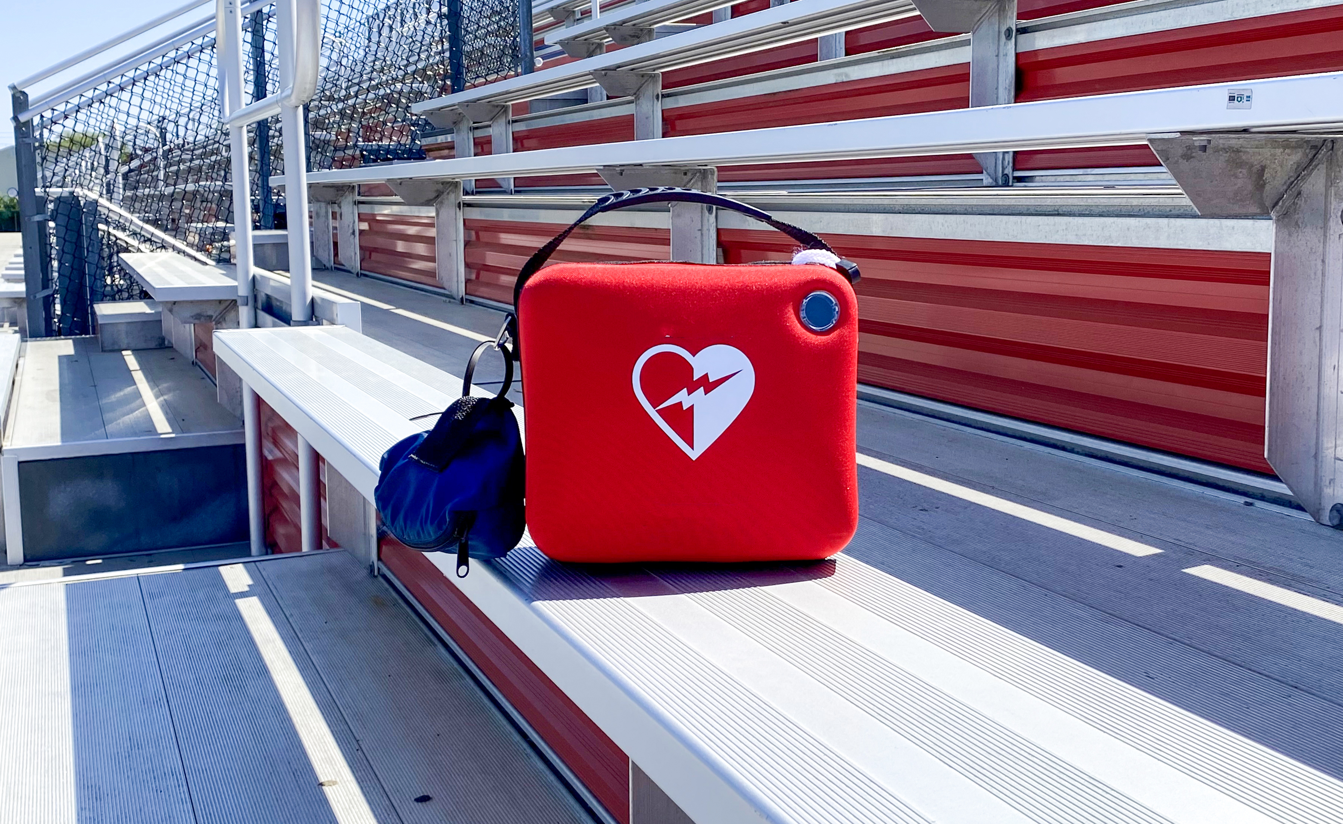
Cardiac Emergency Response drill
Drills will happen at minimum 2 times a year
Unannounced
When you hear “Code _____”
Cardiac Emergency Response Team will follow their specific steps
If you are not a team member keep students in the classrooms and stay out of the hallways
All staff should make every effort to protect the privacy and dignity of the victim, while also protecting their students from the trauma of such an incident
Notes:
Speaker Comments:
*If you are not a team member, keep your students in their classroom and stay out of the hallways. If your classroom is near a team member, make sure their students are supervised so the team member can attend to the victim. All staff should make every effort to protect the privacy and dignity of the victim, while also protecting their students from the trauma of such an incident.
Next, explain to all staff the frequency and process for conducting Cardiac Emergency Response (AED) Drills in your school (i.e. our drill will be sometime in __________). Do NOT give them an exact date, just a general timeframe.
All other personnel should clear the area and should take care to keep students away from the victim and out of the hallways. When EMS has left the premises, the front office should notify the staff with an overhead announcement: “Staff may resume normal activities at this time.”
Sample Drill Video: https://www.youtube.com/watch?v=U1iqmAsnvxg (This Project ADAMS video) Would like to create something similar for Project SAVE

Slide 25
Summary
Sudden Cardiac Arrest is a life-threatening emergency and requires immediate action.
Survival depends on:
Early CPR
Quickly applying the AED
Activation of advanced emergency care
Knowledge and planning

Slide 26
Questions?
Notes:
Speaker Comments:
Are there any questions? Does everyone understand our plan? Remember, we could do the AED drill in front of your classroom and pull you to participate, so it’s important you understand the process!

Slide 27
Thank You!
We are in position to contribute to prevention and to improve outcomes through our vision, awareness, education, knowledge and advocacy.

